Slide 1
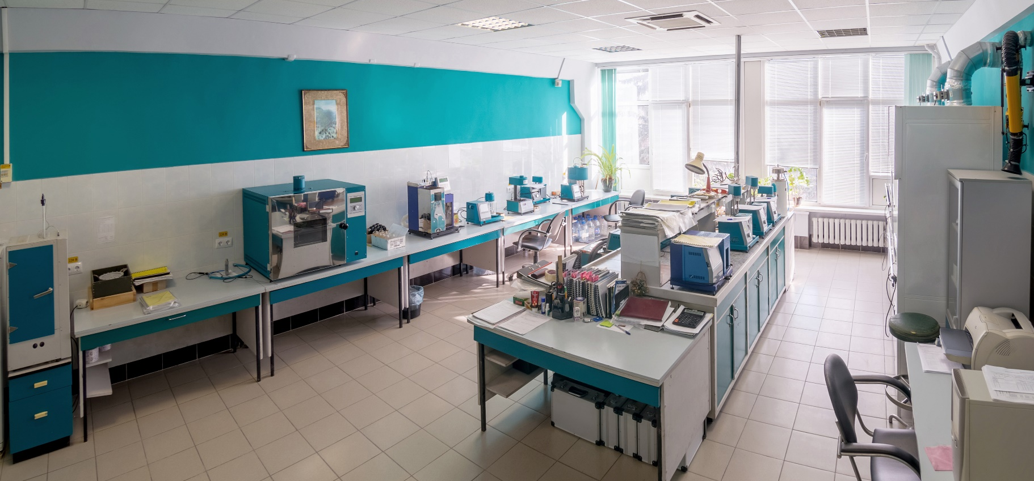
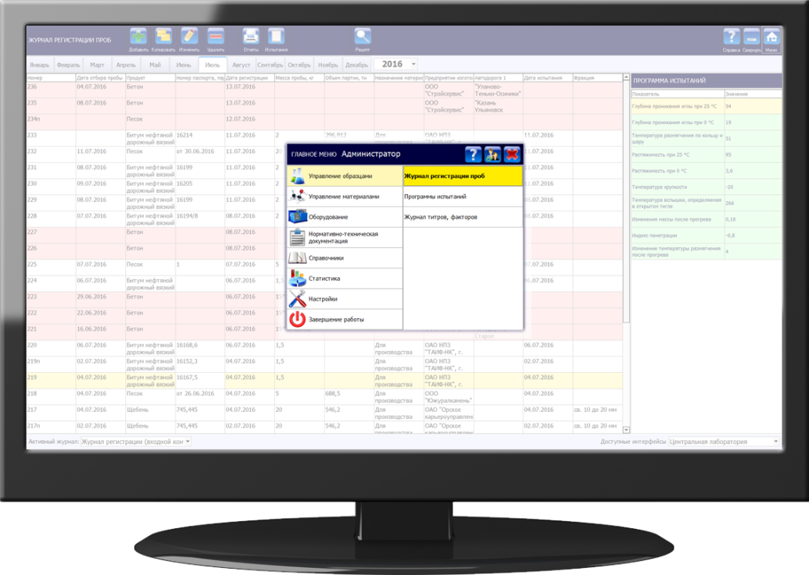
Automation of laboratories by means of laboratory information management system
LinteL LIMS

Slide 2
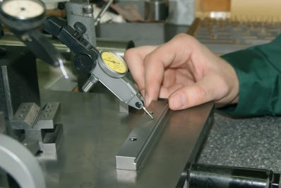
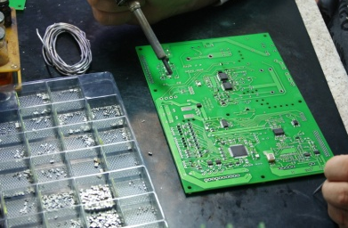
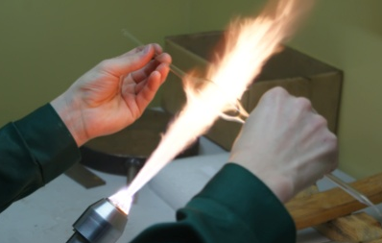
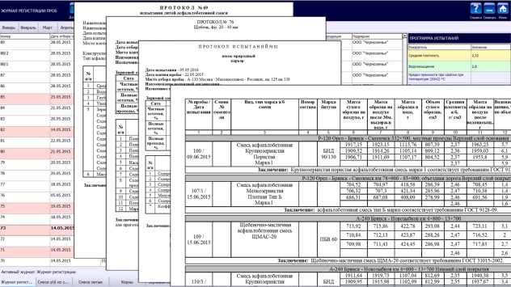
THE COMPANY
Neftekhimavtomatika is a Russian leading developer and producer of automatic devices for quality control of different products: fuels, oils, greases, bitumen and bituminized materials, catalysts, asphalt concrete, geotextiles and other products.
TYPES OF ACTIVITY:
Development and production of laboratory quality control devices.
Automation of laboratory activities based on self-engineered product – LinteL LIMS laboratory information management system.
Provision of testing laboratory services: products testing, preparation of summaries.

Slide 3
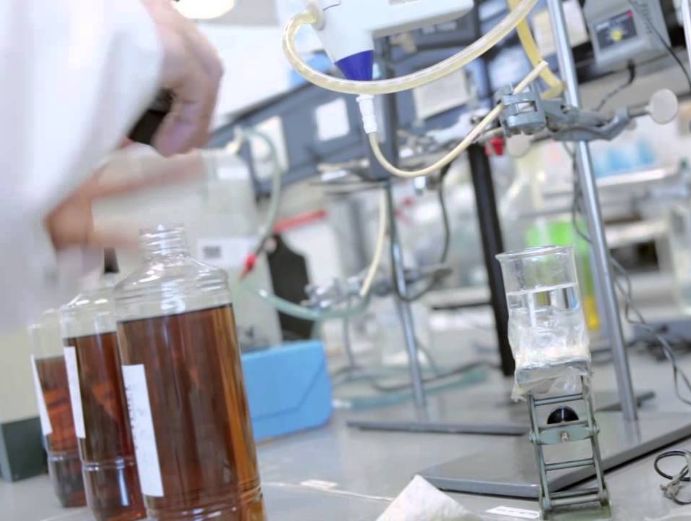
INDUSTRY EXPECTATIONS FROM AUTOMATION OF LABORATORY ACTIVITIES
Modern laboratory systems must be able to:
Provide quality assurance for test results.
Reduce costs for submitting the test results to the customers.
Simplify compliance with requirements for accreditation.
Provide effective personnel and equipment management.
Manage quality of using State Standard Samples and expendable materials.

Slide 4
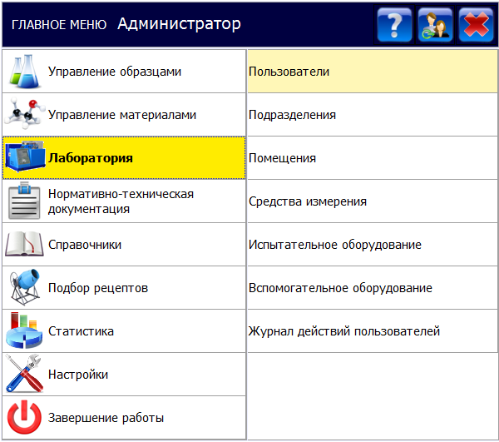
LABORATORY INFORMATION MANAGEMENT SYSTEM LINTEL LIMS
What LinteL LIMS can help with:
Enhancement of work quality and reduction of costs for testing
Main and support system modules
Registry and monitoring of samples moving
Accounting of chemical agents, materials and standard samples
Equipment management (verification, certification, maintenance)
Quality management (QMS, in-house quality management)
Plans, work schedules and progress monitoring
Management of personnel and their competence
Statistics and analytics

Slide 5
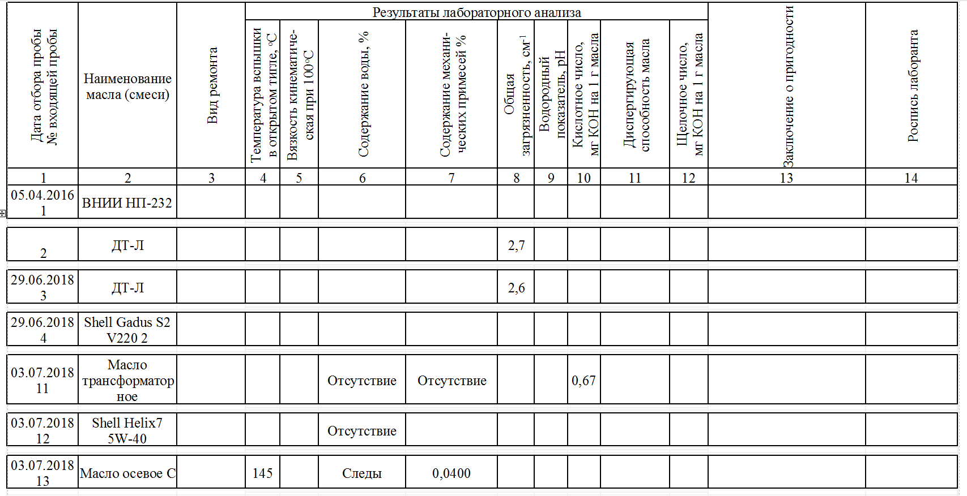
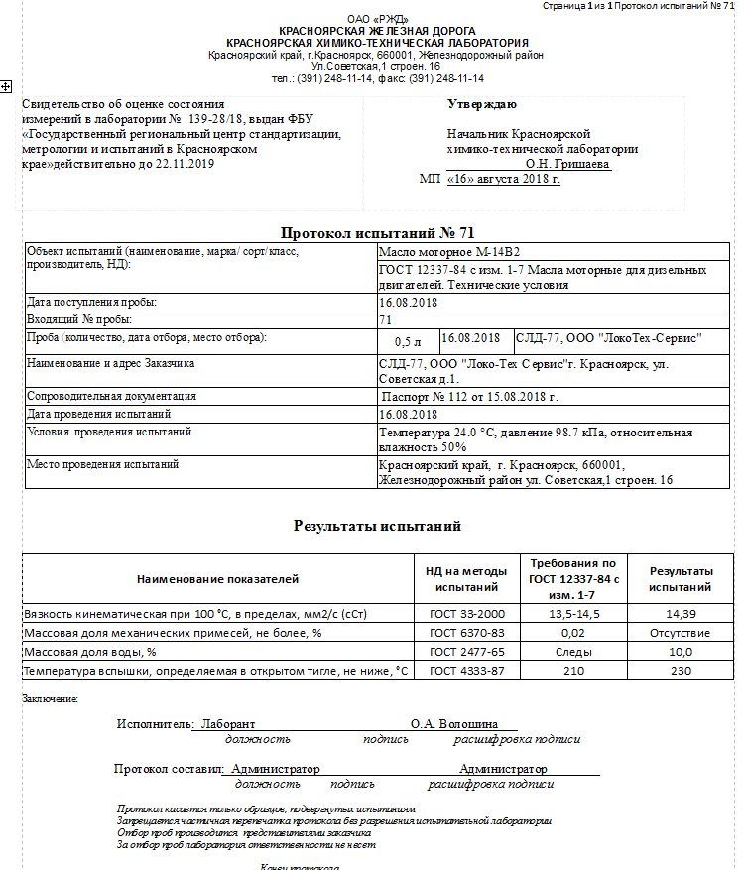
LABORATORY INFORMATION MANAGEMENT SYSTEM LINTEL LIMS
What LinteL LIMS can help with:
Risk mitigation and no penalties during laboratory competence confirmation
Automatic calculation of test results and control of their compliance with product specifications
Automatic logging and printing of any reporting documents (logbooks, certificates, records, etc.)
Complete data check and its export in respective format for Rusaccreditation federal government information system
Generation of reporting documentation in accordance with laboratory accreditation criteria (IEC Order No. 326)
Identification by labels with QR-code
Data protection from unauthorized access and changing

Slide 6
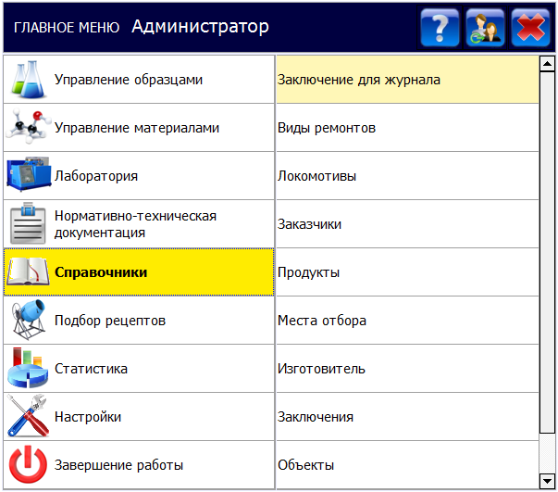
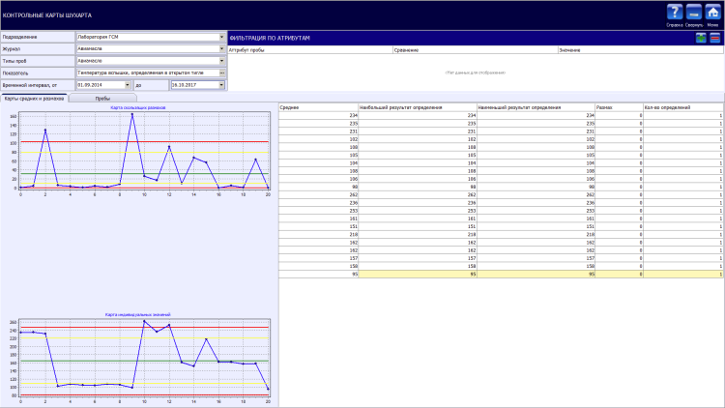
LABORATORY INFORMATION MANAGEMENT SYSTEM LINTEL LIMS
What LinteL LIMS can help with:
Quality management of laboratory activities
Planning of internal audits
Registration of non-conformities
Planning of corrective and preventive actions
In-house quality management and generation of Shewhart control charts
Interlaboratory comparison studies

Slide 7
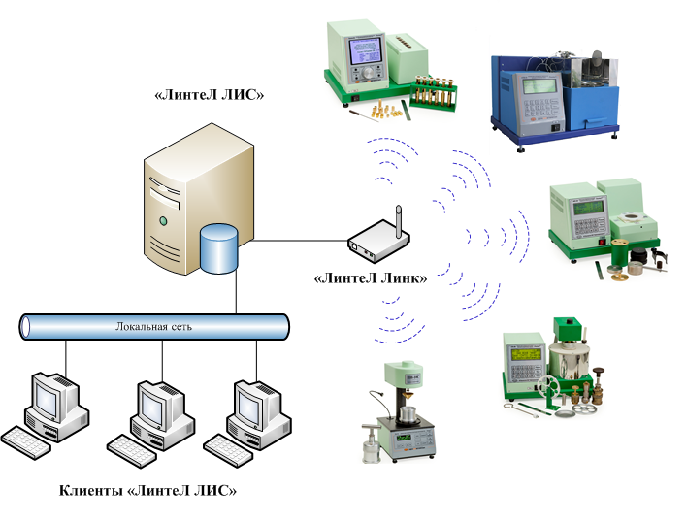
LABORATORY INFORMATION MANAGEMENT SYSTEM LINTEL LIMS
What LinteL LIMS can help with:
Integration with laboratory equipment and information management systems
Quality control devices of different manufacturers can be integrated with LinteL LIMS laboratory information management system
The solution allows to obtain testing results automatically from the devices and to abandon keeping equipment operation logbooks
Interface protocols of laboratory devices produced by Neftekhimavtomatika are fully compatible with LinteL LIMS system
LinteL LIMS
LinteL Link
Local network
LinteL LIMS clients

Slide 8
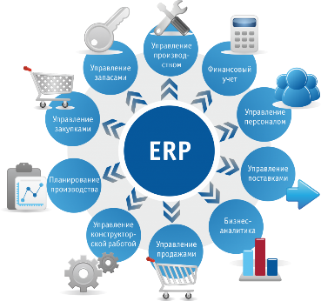
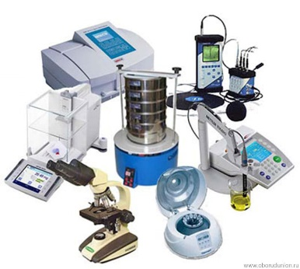
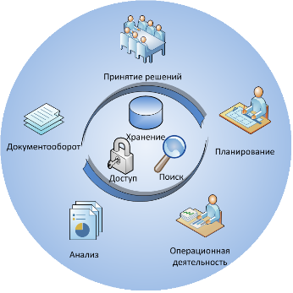
LABORATORY INFORMATION MANAGEMENT SYSTEM LINTEL LIMS
LinteL LIMS advantages over other laboratory systems
Considerable experience in implementation of large-scale projects for total automation of laboratories
LinteL LIMS comprises the description of entire subject area of the laboratory (calculation methods, regulations, templates, requirements, reference guides)
Complete integration with Neftekhimavtomatika laboratory equipment and connection of off-brand devices
Potential for creation of unified information platform of an enterprise with an ability to automatically transmit data and reports to the parties concerned
Experience of integration with different information management systems for accounting and management of enterprise activities
Decision making
Document flow
Storage
Planning
Access
Search
Production management
Stock management
Financial accounting
Analysis
Operating activities
Procurement management
Personnel management
Production planning
Supply management
Engineering activity management
Business analytics
markets management

Slide 9
PRODUCTION OF QUALITY CONTROL DEVICES | LABORATORY AUTOMATION
Large-scale projects for automation and instrumentation of laboratories:
JSC “RZD” (Russian Railways) – integrated supply of more than 300 units of laboratory devices for fuels and lubricants quality control. Pilot project for automation of Krasnoyarsk Chemical and Toxicological Laboratory by means of LinteL LIMS.
JSC “Tatavtodor” – integration of 11 laboratories within the LinteL LIMS common information space, with their activity fully traceable from the central laboratory.
JSC “Gaspromneft-Aero” – global automation project covering 5 laboratories, with a perspective of all company branches integration.
Federal Road Agency “Rosavtodor” – pilot project of laboratory automation, development of industry standard and assignment for automation of more than 30 laboratories of subordinate organizations.
JSC “Gaspromneft – Bitumen materials” – terms of reference approved for automation of laboratories of large-scale manufacturers of bitumen and bituminous materials.

Slide 10
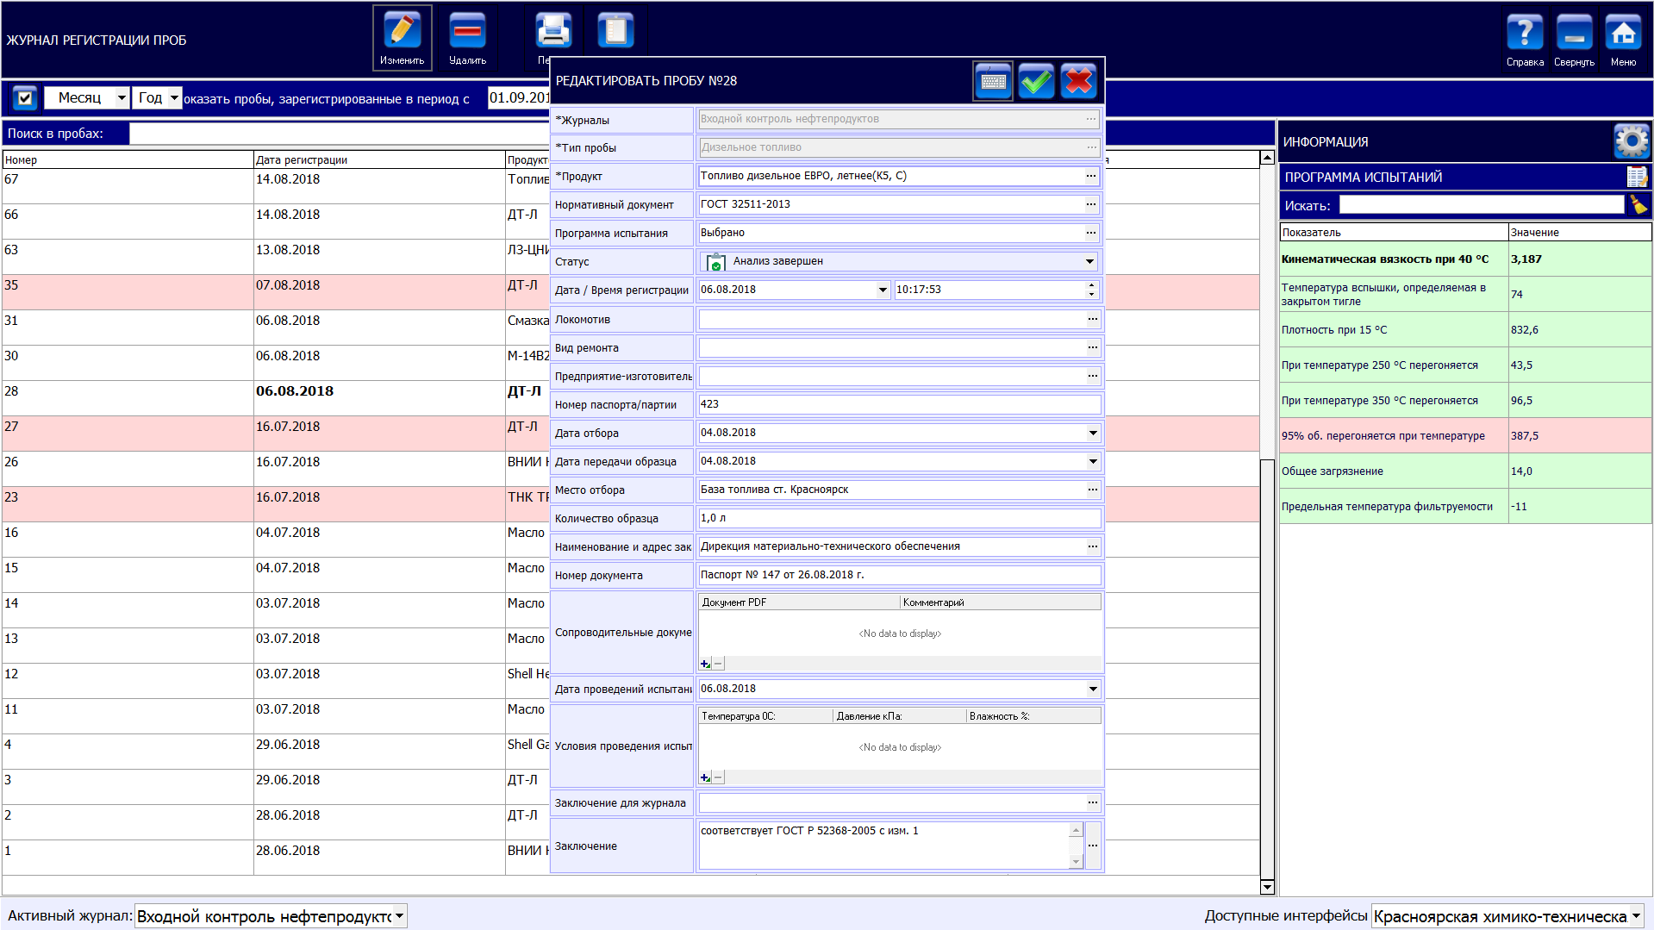
EXAMPLE OF LINTEL LIMS USING
Diesel oil quality control
Step 1. Sample registration
Select sample type.
Select test program.
Fill in information on the sample using reference guides.

Slide 11
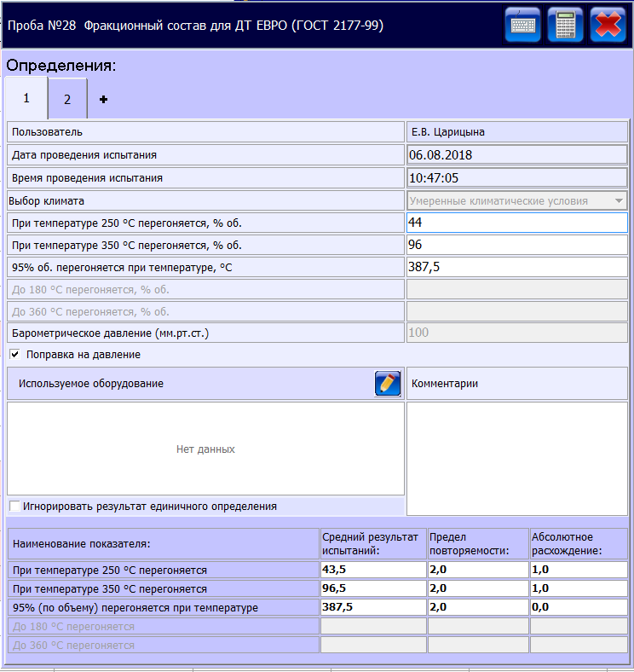
EXAMPLE OF LINTEL LIMS USING
Diesel oil quality control
Step 2. Calculation of results
Input initial data for the first determination.
Automatic calculation of determination result in accordance with the method.
Input initial data for the next determination.
Automatic calculation of parallel determination result.
Automatic calculation of final test result and repeatability control.

Slide 12
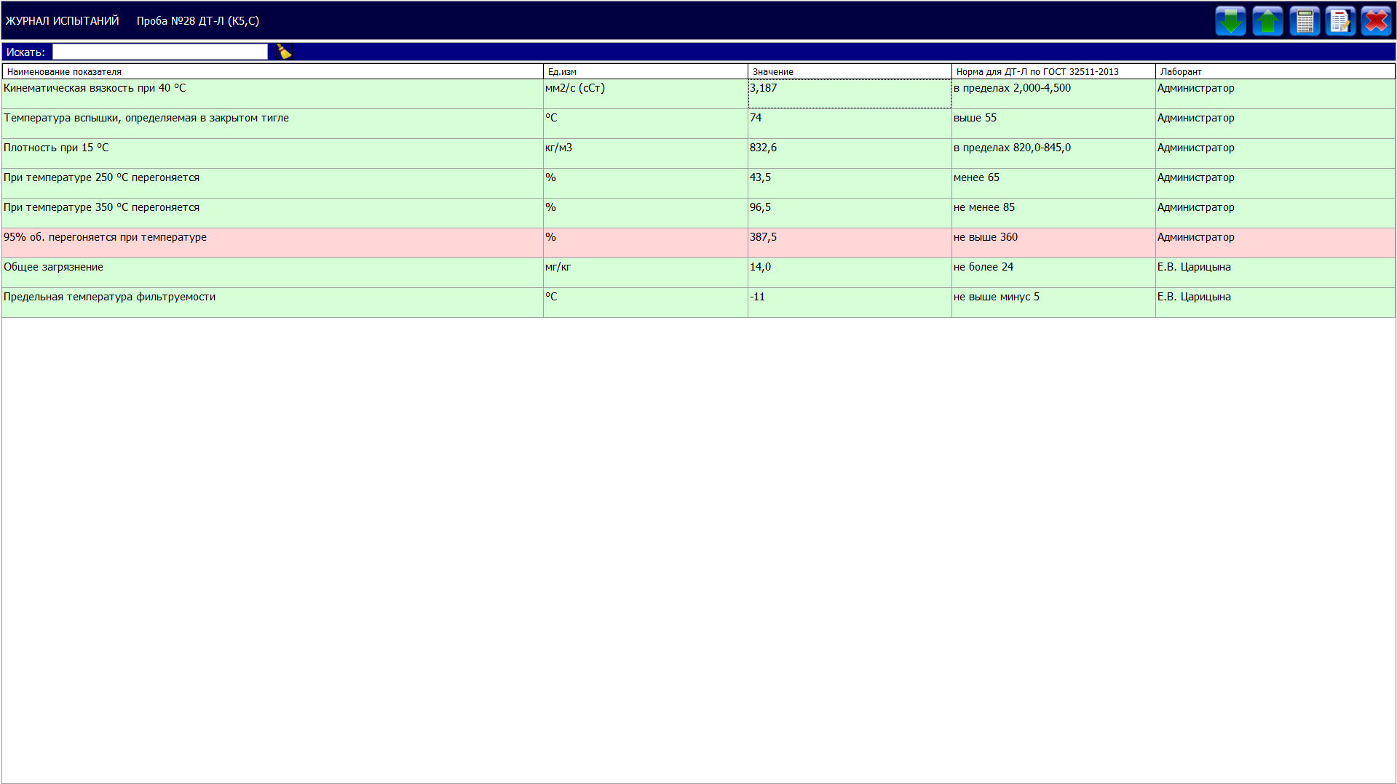
EXAMPLE OF LINTEL LIMS USING
Diesel oil quality control
Step 3. Check of compliance of the results obtained with regulatory requirements for the product
Automatic control of compliance of the test results obtained with regulatory requirements for the product.
Notice on incorrect test results.

Slide 13
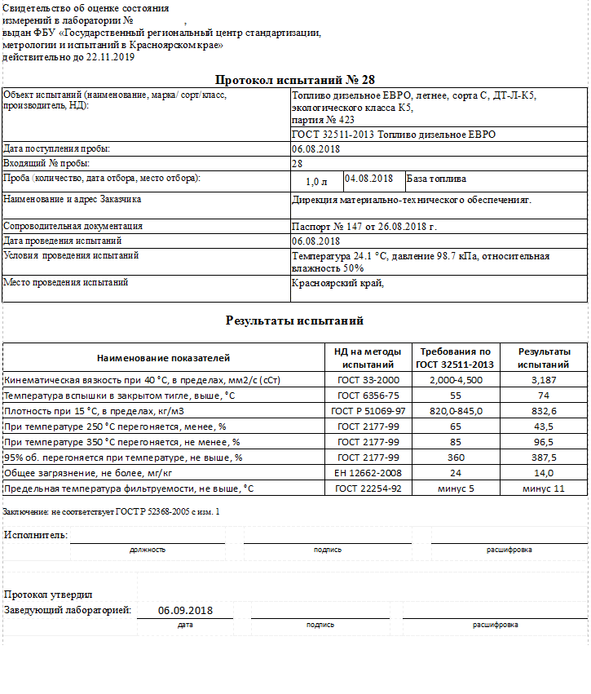
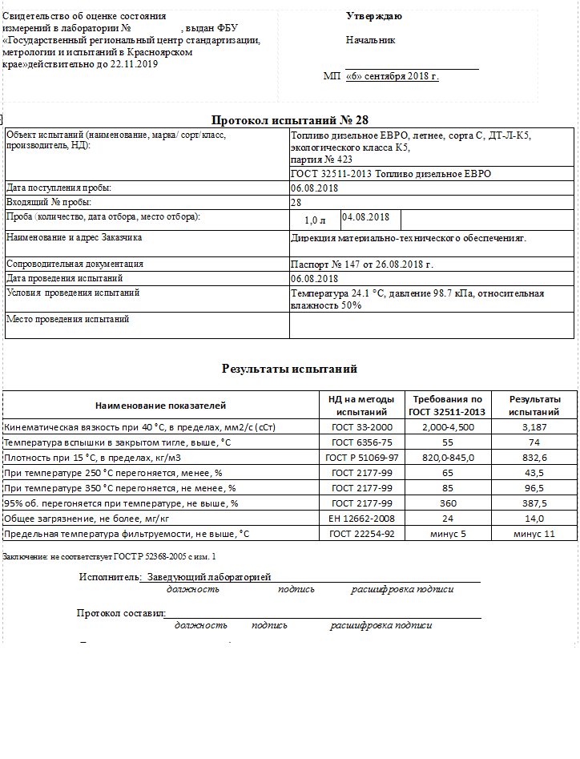
EXAMPLE OF LINTEL LIMS USING
Diesel oil quality control
Step 4. Preparation of summary
Select reporting document type from the reference guide.
Automatic generation of report (certificate, record, summary, etc.) in accordance with the template approved.
Approve the report and protect results from changing.
Sign original document and attach copy.

Slide 14
CONTACT INFORMATION
Our company provides services for R&D, engineering and production of quality control devices, as well as operations automation and software development.
Neftekhimavtomatika company is ready to consider your offers for long-term and mutually beneficial cooperation!
www.bashnxa.ru

